Slide 1
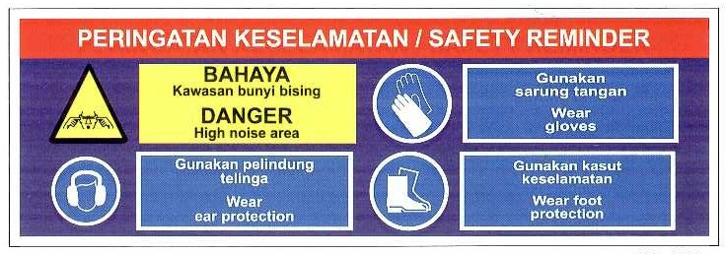
TOP GLOVE, TOP QUALITY, TOP EFFICIENCY
GOOD HEALTH, SAFETY FIRST & BE HONEST
Safety and Health Department
SAFETY
FIRST
SAFETY
FIRST
ACCIDENT REPORT
FOR
AUGUST 2011
PRESENTER:-
Mohd. Shahpezam, Security, Safety and Health Officer.(F21)
Arshad Khamis, Asst. Security, Safety and Health Officer.(F13)
Mohamad Fazly, Asst. Security, Safety and Health Officer.(F21)
Amir Ramly, Security, Safety and Environmental Officer. (F12)

Slide 2
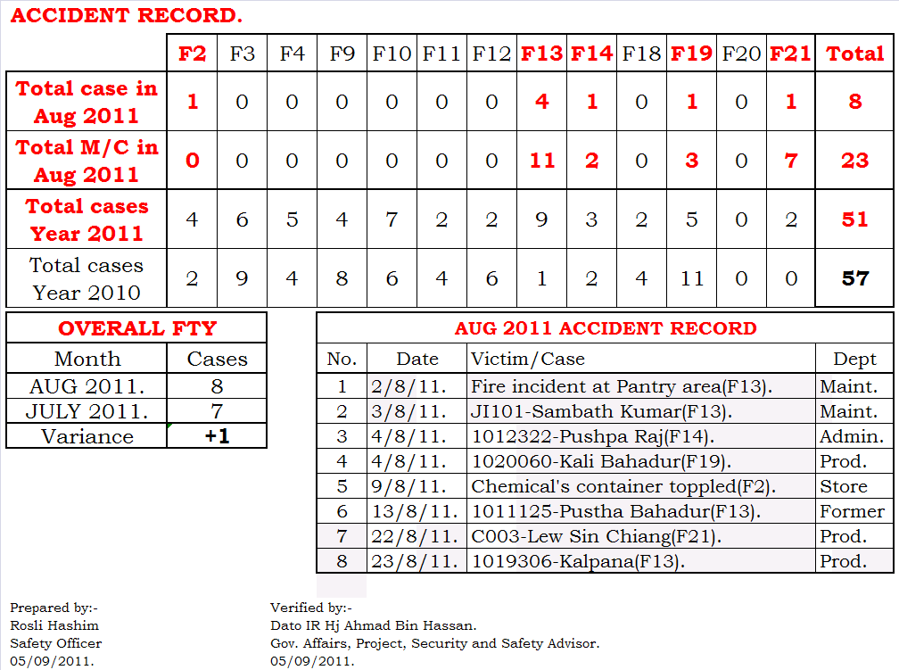
TOP GLOVE, TOP QUALITY, TOP EFFICIENCY
GOOD HEALTH, SAFETY FIRST & BE HONEST
Safety and Health Department
SAFETY
FIRST
SAFETY
FIRST

Slide 3
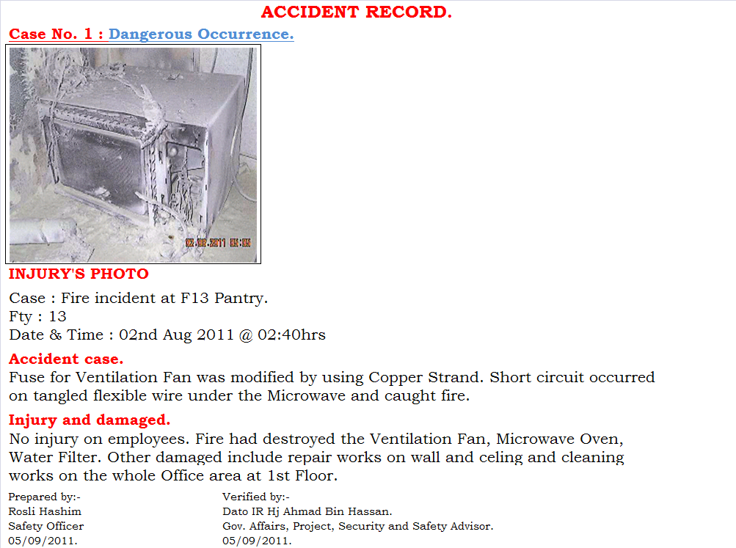
TOP GLOVE, TOP QUALITY, TOP EFFICIENCY
GOOD HEALTH, SAFETY FIRST & BE HONEST
Safety and Health Department
SAFETY
FIRST
SAFETY
FIRST

Slide 4
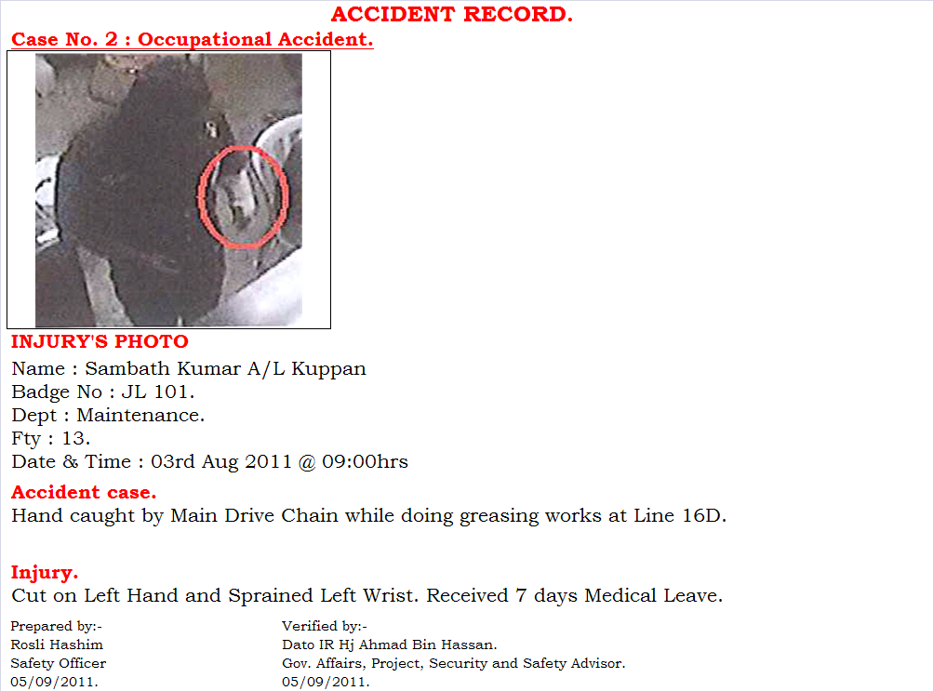
TOP GLOVE, TOP QUALITY, TOP EFFICIENCY
GOOD HEALTH, SAFETY FIRST & BE HONEST
Safety and Health Department
SAFETY
FIRST
SAFETY
FIRST

Slide 5
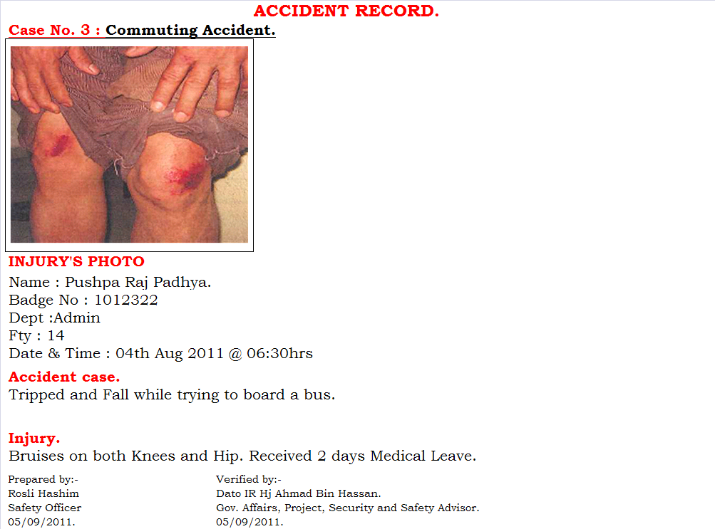
TOP GLOVE, TOP QUALITY, TOP EFFICIENCY
GOOD HEALTH, SAFETY FIRST & BE HONEST
Safety and Health Department
SAFETY
FIRST
SAFETY
FIRST

Slide 6
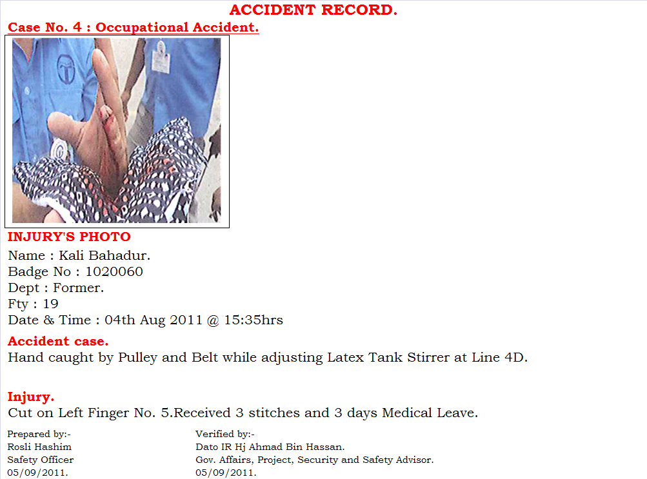
TOP GLOVE, TOP QUALITY, TOP EFFICIENCY
GOOD HEALTH, SAFETY FIRST & BE HONEST
Safety and Health Department
SAFETY
FIRST
SAFETY
FIRST

Slide 7
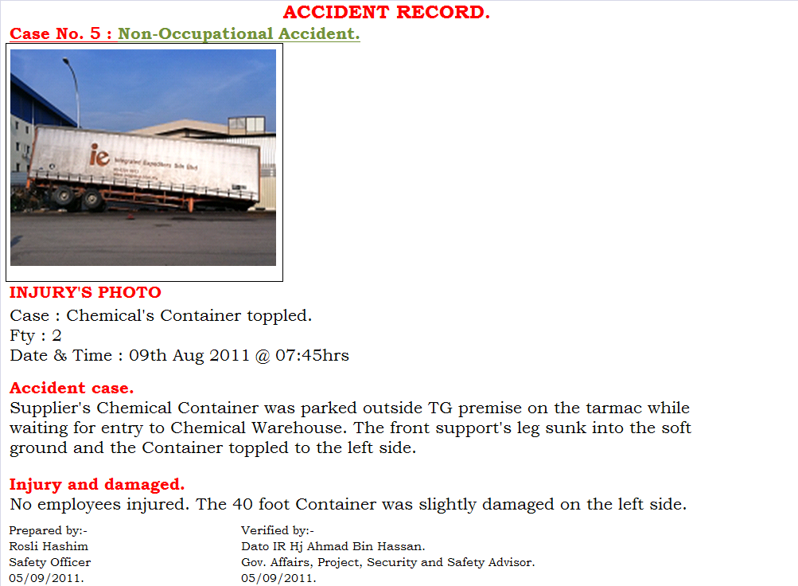
TOP GLOVE, TOP QUALITY, TOP EFFICIENT
GOOD HEALTH, SAFETY FIRST & BE HONEST
Safety and Health Department
SAFETY
FIRST
SAFETY
FIRST

Slide 8
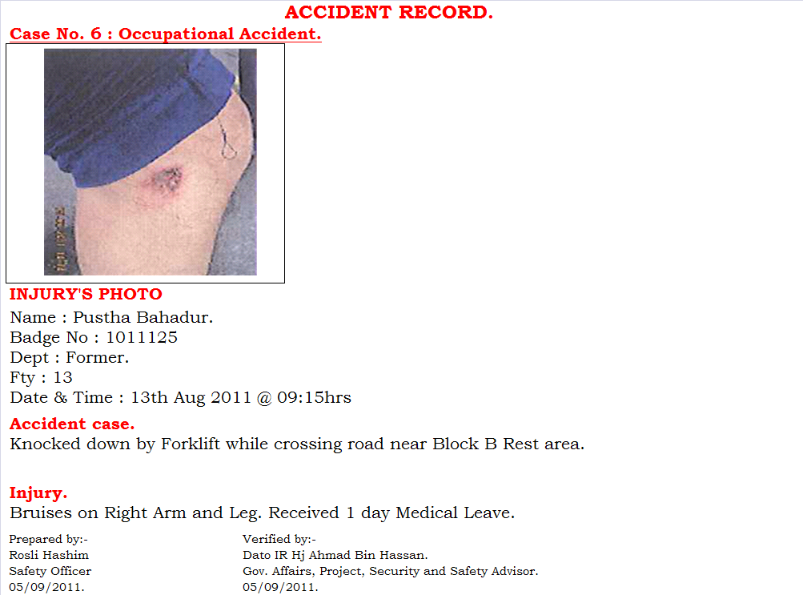
TOP GLOVE, TOP QUALITY, TOP EFFICIENT
GOOD HEALTH, SAFETY FIRST & BE HONEST
Safety and Health Department
SAFETY
FIRST
SAFETY
FIRST

Slide 9
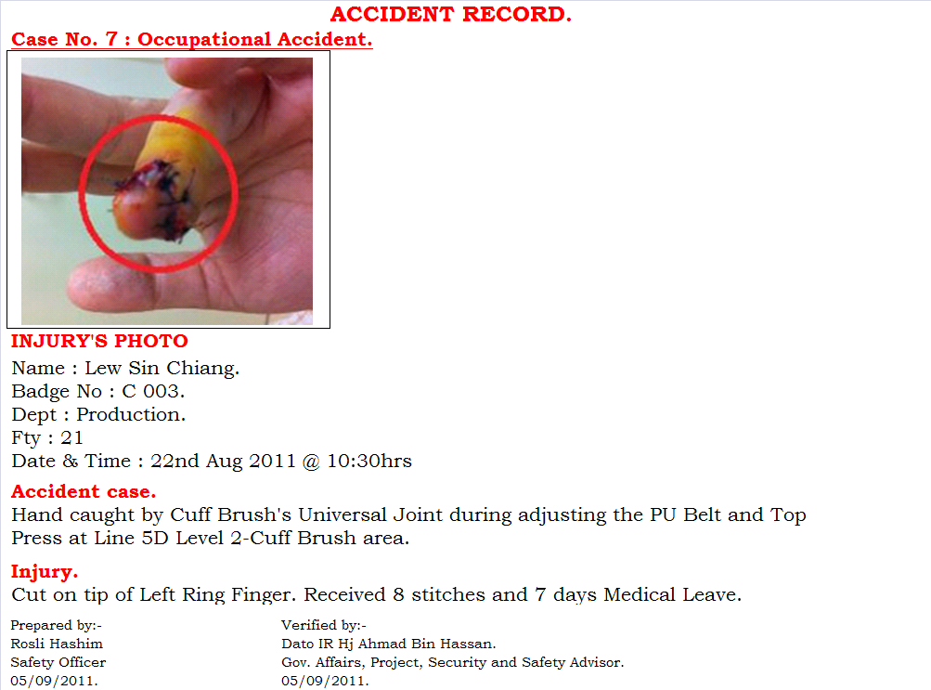
TOP GLOVE, TOP QUALITY, TOP EFFICIENT
GOOD HEALTH, SAFETY FIRST & BE HONEST
Safety and Health Department
SAFETY
FIRST
SAFETY
FIRST

Slide 10
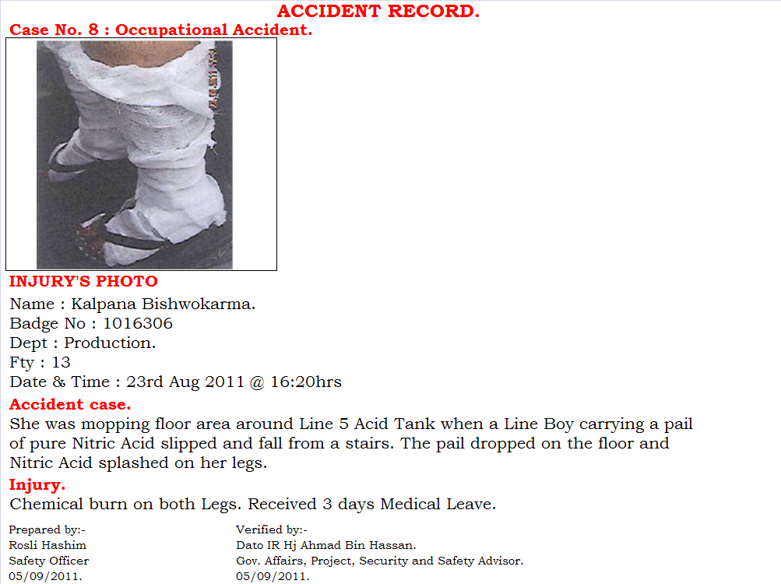
TOP GLOVE, TOP QUALITY, TOP EFFICIENT
GOOD HEALTH, SAFETY FIRST & BE HONEST
Safety and Health Department
SAFETY
FIRST
SAFETY
FIRST

Slide 11
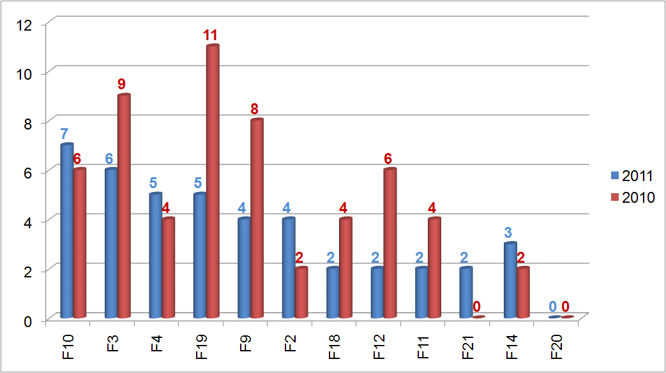
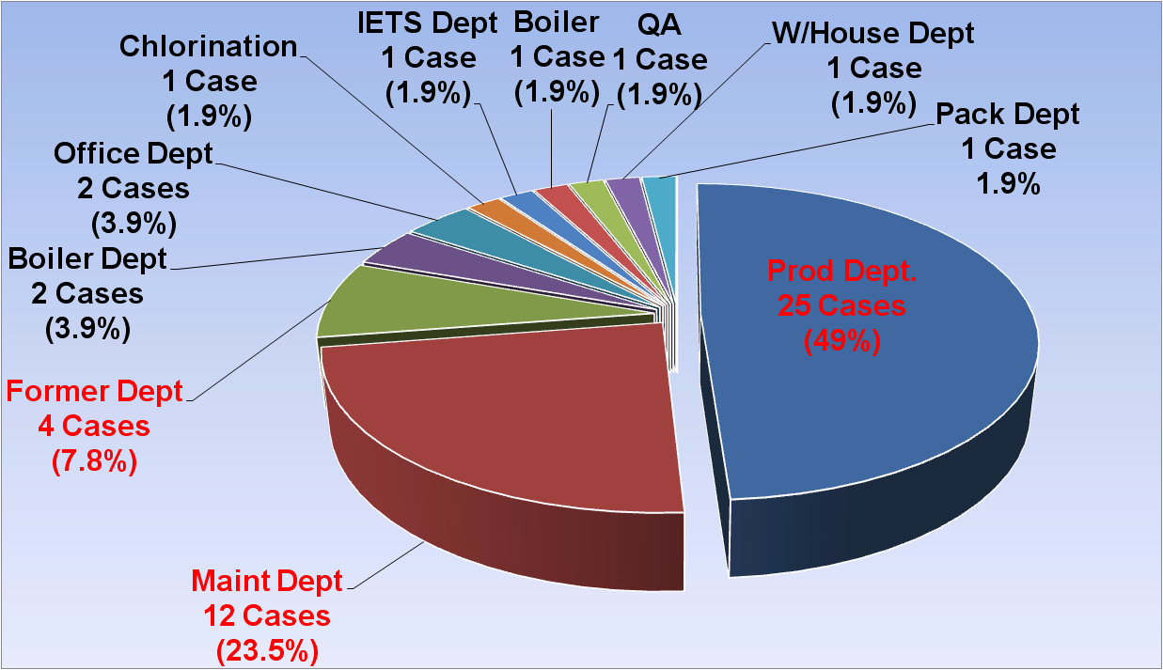
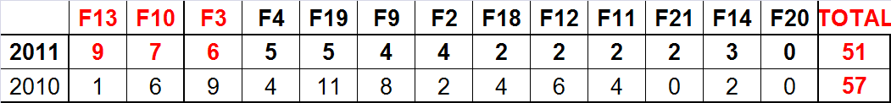
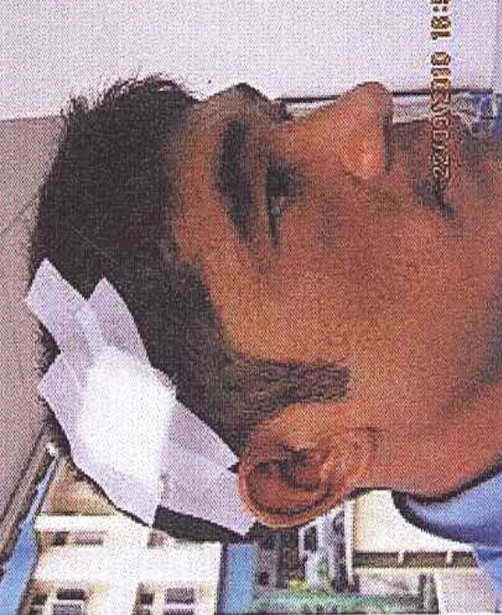
TOP GLOVE, TOP QUALITY, TOP EFFICIENCY
GOOD HEALTH, SAFETY FIRST & BE HONEST
Safety and Health Department
SAFETY
FIRST
SAFETY
FIRST
HIGHEST ACCIDENT CASE IN YEAR 2011
FACTORY
DEPARTMENT

Slide 12
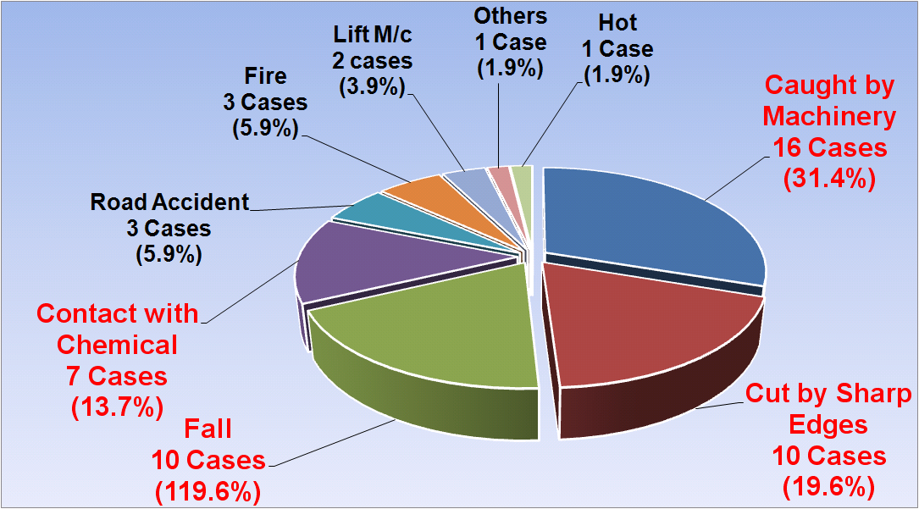
TOP GLOVE, TOP QUALITY, TOP EFFICIENCY
GOOD HEALTH, SAFETY FIRST & BE HONEST
Safety and Health Department
SAFETY
FIRST
SAFETY
FIRST
HIGHEST ACCIDENT CASE IN YEAR 2011
TYPE OF ACCIDENT

Slide 13




TOP GLOVE
TOP QUALITY, TOP EFFICIENT & GOOD HEALTH
Safety and Health Department
SAFETY
FIRST
SAFETY
FIRST
THE END & THANK YOU

